Slide 1
A Lightweight Python Package for Industrial Time Series Analysis

Slide 2
Data loading and resampling
Data in JSON format, input with timestamp and value
Example: {'timestamp': ..., 'value': ...}
Timestamps are not evenly spaced
Need to resample the data to regular intervals (e.g., 1 second)
Resampling introduces missing values
Gaps are filled using the nearest known values
(interpolation method)

Slide 3
State detection and outliers removal
We use median filtering to detect states
To be separed: Production and Standby
Median filtering helps reduce outlier influence
Why This Approach?
Low computational cost
Fast and simple implementation
No machine learning or training data required

Slide 4
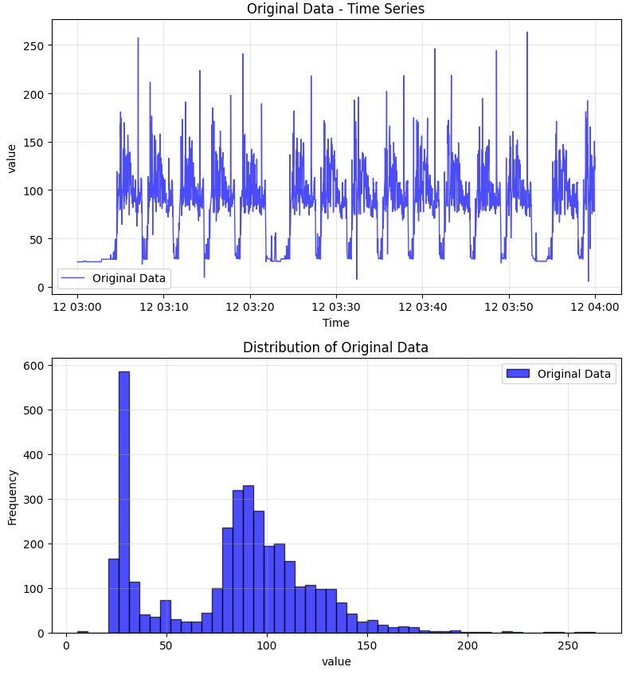
Before outlier removal

Slide 5
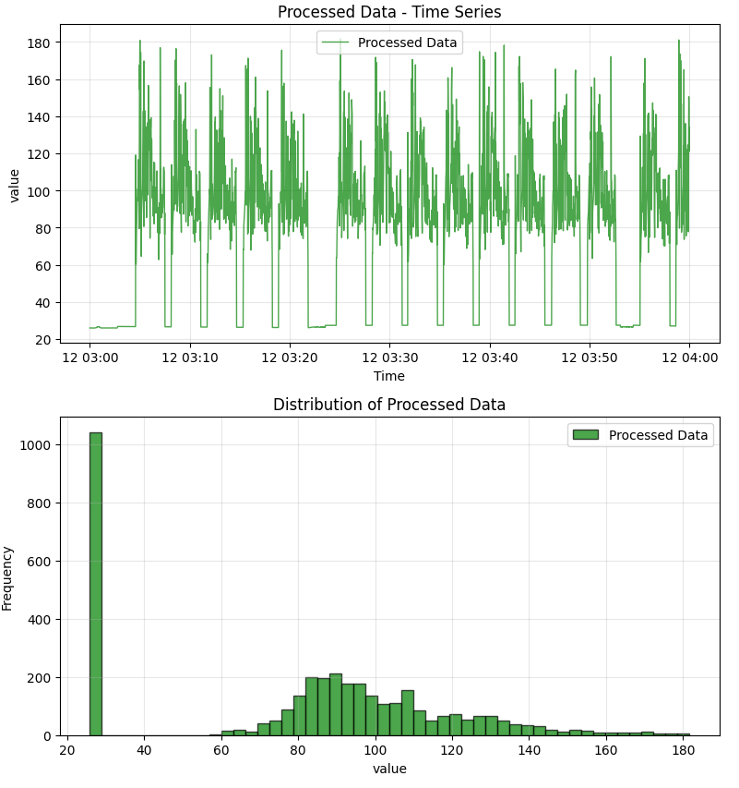
After outlier removal

Slide 6
Focus on Production States
After state detection, extract production segments
These are the basis for performance evaluation

Slide 7
Cycle Comparison
Compare each production cycle to a standard one
Identify the most deviating cycles
Helps in anomaly detection and diagnostics
Assigning grade to the number of deviating pattern
A : no issue
B : 1 issues
C : 2 issues
D : 3 issues

Slide 8
Conclusion
Lightweight and interpretable solution for industrial data
Works in real-time environments
Easily extendable with visualization and reporting tools

